Slide 1



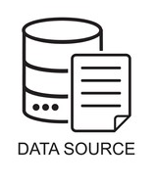
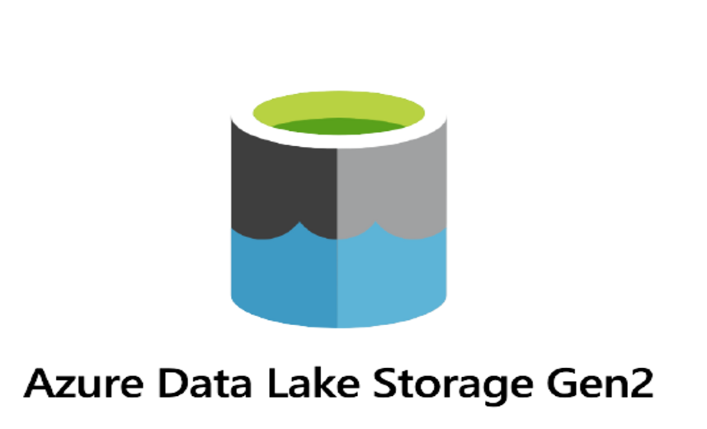
Transformation and Analysis
Dashboard
Data Ingestion in data factory
Raw Datastore
Raw Datastore

